Slide 1

National Research University Higher School of Economics Faculty of Computer Science
Master’s Programme ‘System and Software Engineering’
OPTICAL FLOW ESTIMATION BASED ON DEEP LEARNING APPROACHES
Student: Attakorah Joseph Afriyie
Supervisor: Professor Hadi Saleh
Moscow, 2019

Slide 2

Faculty of Computer Science / Master’s Programme ‘System and Software Engineering’
INTRODUCTION
Images have special characteristics;
Videos have specific temporal resolution characteristics i.e. frame per second (fps);
Optical Flow is the pattern of apparent motion of an object in a visual scene caused by the relative motion between an observer and the scene;
Computer Vision technique.

Slide 3
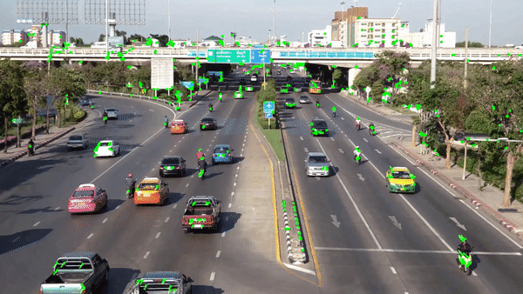
Faculty of Computer Science / Master’s Programme ‘System and Software Engineering’
Description of Subject AREA
Scene

Slide 4
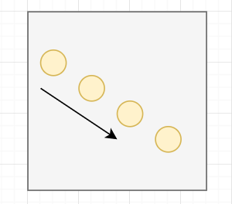
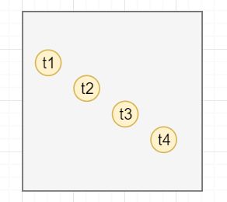
Optical Flow
An object moves from the top left to bottom right

Slide 5
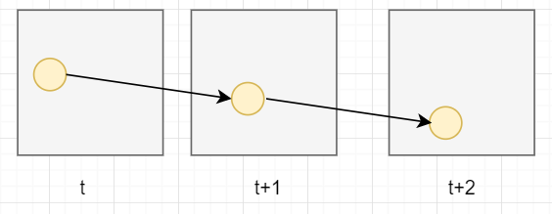
Optical Flow: Video frames

Slide 6
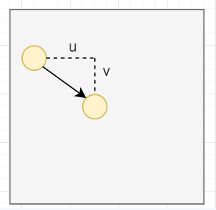
Optical Flow Estimation Problem
How do we estimate the displacement?

Slide 7
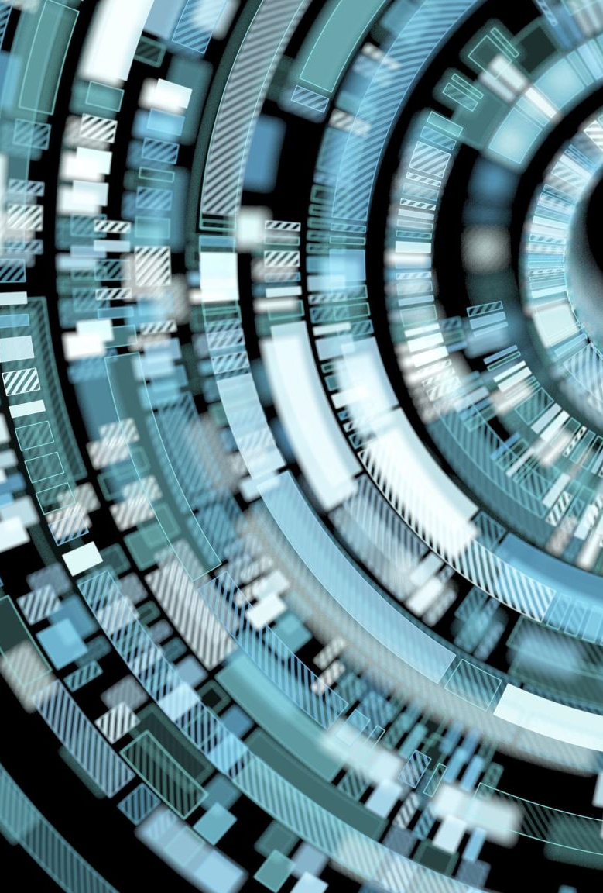
Optical Flow Estimation Problem
- The problem of optical flow has historically been an optimization problem in computer vision
- Recent approaches by applying deep learning have shown impressive results.
Relevance and Use
Motion detection, video compression, Motion estimation and video compression have developed as a major aspect of optical flow research

Slide 8
Motivation
Recently, CNNs have been successfully used in estimating optical flow. Compared with traditional methods, these methods achieved a large improvement in quality.
Since optical flow is used in motion detection, video compression and several safety-critical applications like self-driving cars, it is important to optimize it to the best of its performance with state-of-the-art.

Slide 9
Faculty of Computer Science / Master’s Programme ‘System and Software Engineering’
Related works
Non-Deep Learning (DL) Method
Title: Determining optical flow. Artificial intelligence, Horn, B. K., & Schunck
Year: 1981
Limitation: complex and computationally expensive in real-time applications
Title: Lucas Kanade method
regarding image patches and an affine model for the flow field
Year: 1981
Limitation: Manually tune all parameters, hence low scalability

Slide 10
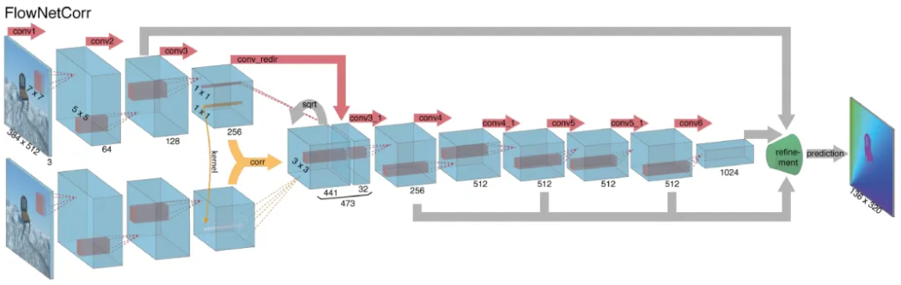
Faculty of Computer Science / Master’s Programme ‘System and Software Engineering’
Related works
Deep Learning (DL) Method
Title:FlowNetCorr
Year: 2015
Advantages: Faster rendering speed than traditional computer vision methods
Limitation: Two images are convoluted separately and are combined by a correlation layer. Poor performance on displacement

Slide 11
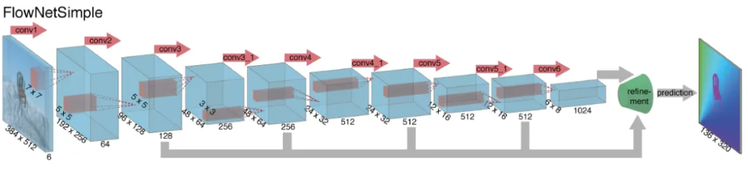
Faculty of Computer Science / Master’s Programme ‘System and Software Engineering’
Related works
Deep Learning (DL) Method
Title: Flownet: Learning optical flow with convolutional networks. (FlowNetS)
Year: 2015
Advantages: Faster rendering speed than traditional computer vision methods
Limitation: simply stacks two sequentially adjacent images as input. Produces noisy and blurred results.

Slide 12
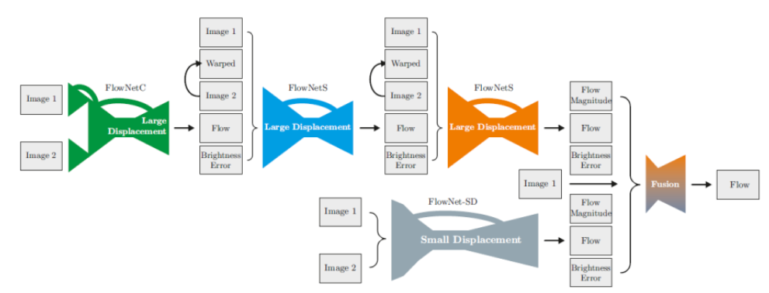
Faculty of Computer Science / Master’s Programme ‘System and Software Engineering’
Related works
Deep Learning (DL) Method
Title: FlowNet 2.0: Evolution of Optical Flow Estimation with Deep Networks
Year: 2016
Advantages: stacked by flownets and flownetcorr, and produces much better results. Based on FlowNet
Limitation: FlowNet 2.0 is only marginally slower than the original FlowNet although decreases the estimation error by more than 50%

Slide 13
Faculty of Computer Science / Master’s Programme ‘System and Software Engineering’
Related works
Deep Learning (DL) Method
Title: Optical Flow Estimation using a Spatial Pyramid Network (Spynet)
Year: 2016
Advantages: much more lightweight, with fewer parameters, faster, and produces large motions in a course to fine manner
Limitation: performs below FlowNet2.0

Slide 14
Faculty of Computer Science / Master’s Programme ‘System and Software Engineering’
Objective
To generate a model which would be able to produce effective optical flow for given input sequence of raw images.
Tasks
Review related works on optical flow; 3 weeks
Understand the dataset which contains images for training; 1 week
Use deep learning approaches and TensorFlow library to generate a model; 1 Month
Test the accuracy by comparing the produced optical flow with ground truth. 1 Month

Slide 15
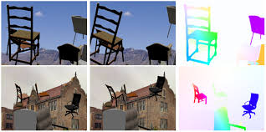
Faculty of Computer Science / Master’s Programme ‘System and Software Engineering’
Methods and Algorithms And Technologies
FlowNet2.0
FlowNetS
FlowNetC
PWC-Net
Popular data sets: FlyingThings3D and KITTI optical flow 2015
Technologies: TensorFlow library and deep learning techniques

Slide 16
Faculty of Computer Science / Master’s Programme ‘System and Software Engineering’
Expected Results And evaluation
Optical Flow Estimation Model (Deep learning model):
- The estimated approach should be able to generate a per-pixel
prediction with images;
- The expected solution would be compared and evaluated with other solutions based on Deep Learning approaches.

Slide 17
Faculty of Computer Science / Master’s Programme ‘System and Software Engineering’
Reference
[1] Ilg, E., Mayer, N., Saikia, T., Keuper, M., Dosovitskiy, A., & Brox, T. (2017). Flownet 2.0: Evolution of optical flow estimation with deep networks. In Proceedings of the IEEE conference on computer vision and pattern recognition (pp. 2462-2470).
[2] Dosovitskiy, A., Fischer, P., Ilg, E., Hausser, P., Hazirbas, C., Golkov, V., ... & Brox, T. (2015). Flownet: Learning optical flow with convolutional networks. In Proceedings of the IEEE international conference on computer vision (pp. 2758-2766).
[3] Sun, D., Yang, X., Liu, M. Y., & Kautz, J. (2018). PWC-Net: CNNs for optical flow using pyramid, warping, and cost volume. In Proceedings of the IEEE Conference on ComputerVision and Pattern Recognition (pp. 8934-8943).
[4] Menze, M., & Geiger, A. (2015). Object scene flow for autonomous vehicles. In Proceedings of the IEEE
[5] Conference on Computer Vision and Pattern Recognition (pp. 3061-3070).
[6] B.D. Lucas, T. Kanade, ”An Image Registration Technique with an Application to Stereo Vision”, in Proceedings of Image Understanding Workshop, 1981, pp. 121-130
[7] Gituma, Mark. “What Is Optical Flow and Why Does It Matter in Deep Learning.” Medium, The Startup, 23 June 2019, https://medium.com/swlh/what-is-optical-flow-and-why-does-it-matter-in-deep-learning-b3278bb205b5
[8] https://nanonets.com/blog/optical-flow/

Slide 18
Thank You for attention
Thanks to Shadi Saleh from Germany
Address: 20 Myasnitskaya Ulitsa, Moscow 101000 Russia | 11 Pokrovsky Boulevard, Moscow 109028 Russia

